Slide 1
Enterprise Security Essentials
Joe Partlow
USF Whitehatters 2015

Slide 2
Enterprise Security Essential Components
The goal of this presentation is to show the the variety of security technologies such as SIEM, IDS/IPS, NAC, DLP, etc. that are present (or should be) in most corporate environments and how they help the overall security posture of the organization. In our example we will be using a scaled down corporate setup with a remote data center, corporate office and a smaller branch office.

Slide 3
Sample Infrastructure
Most environments are much larger, but usually are just adding more data centers or branch offices.
Broken down to 4 high-level areas:
Perimeter/Core Security
Endpoint Security
Data Security
Overall Security Management

Slide 4
Key Zones or Network Segments
The following zones or network segments are usually found to some extent in every corporate environment:
Perimeter – Public facing edge of the network
De-Militarized Zone (DMZ) – Servers providing public services, but mostly protected from the outside
Management Network – Restricted area of the network used for central management or security appliances
Internal Corporate Network – Internal corporate users
Branch Offices – Remote offices with corporate users
Compliance Zones – Any protected area that has access to sensitive data such as customer financial or medical records governed by PCI, HIPAA, etc.

Slide 5
Base Networking
Below are some components common to most networks and provide base connectivity.
Firewalls – Not counting those since they are as common as switches and Routers (Palo Alto, Cisco, Juniper, Fortinet)
Active Directory (AD) Server – Microsoft product for central user and host management. Also performs internal DNS functions
Access Switches – Switches that clients usually connect to. Can also be VLANs on a bigger switch instead of separate smaller physical switches.
Distribution Switches – Aggregate multiple Access Switches or multiple locations. Roll up to Core Switches

Slide 6
Base Networking – Cont.
Dynamic Host Configuration Protocol (DHCP) Server – Assigns IP addresses to most user workstations. Can be a standalone server or performed from infrastructure components such as wireless access points or switches.
Domain Name System (DNS) Server – Responsible for looking up and resolving all names to IP addresses. (Infoblox, Microsoft, Bind)
Routers – Responsible for taking traffic from one network to another.
Wireless Controller – Central management of all wireless access points on the network.
Load Balancer – Appliance for directing traffic (usually web) across multiple webservers for performance and redundancy. (F5, Kemp, Brocade)

Slide 7
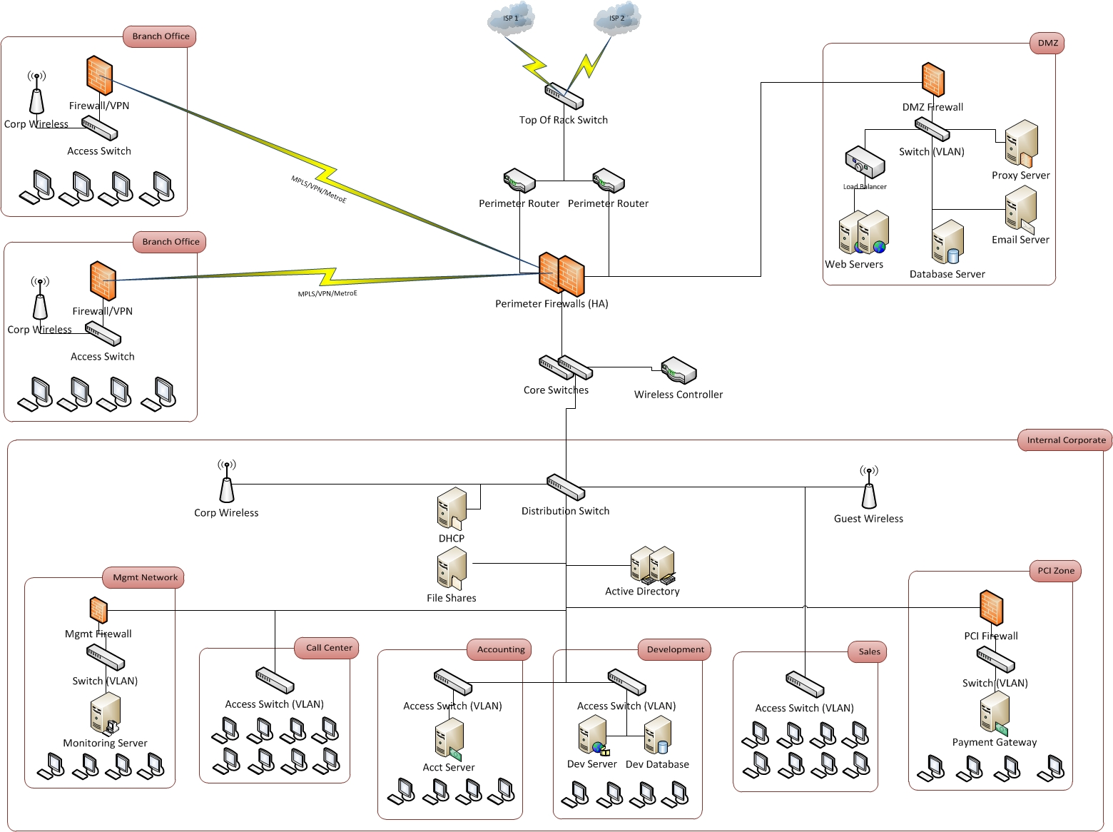
Base Network Diagram

Slide 8
Perimeter/Core Security
Usually the perimeter is the first to get secured, below are some key security components needed by most environments.
Intrusion Detection/Prevention System (IDS/IPS) – Need to put on every egress point or key internal segments, can be in-line or on a span port. Wireless IDS sometimes built into the Controller. (Sourcefire, Palo Alto, McAfee)
Security Information & Event Management (SIEM) – Must have visibility into everything, best practice to include log aggregators in each major zone/area/segment. (splunk, ArcSight, Qradar, McAfee, LogRhythm)
Web Application Firewall (WAF) – Checks no unauthorized/malicious request are sent to the web servers, typically looking for sql injection. Some Load Balancers also include this functionality. (F5, Imperva)
Distributed Denial of Service (DDoS) Protection – Could be appliance on premise or in the cloud. (Corero, Prolexic, Radware)

Slide 9
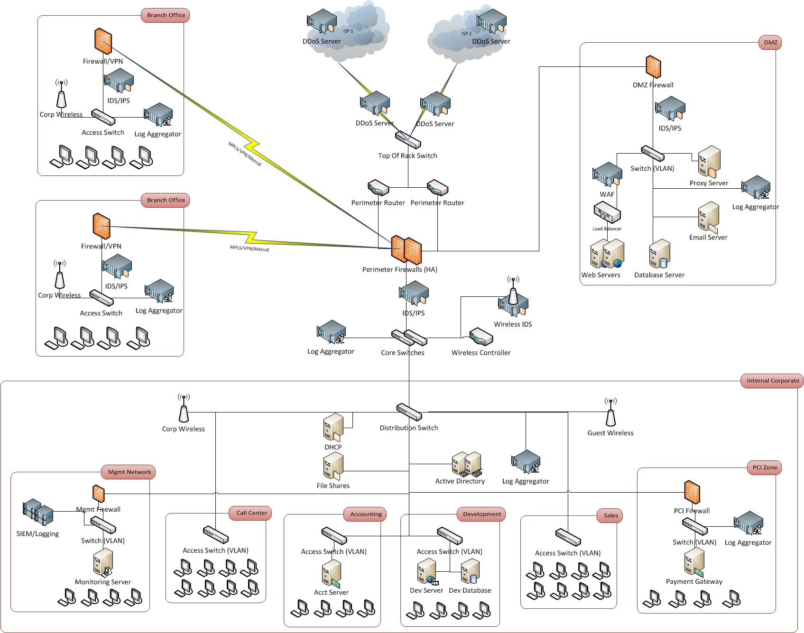
Perimeter Security Diagram

Slide 10
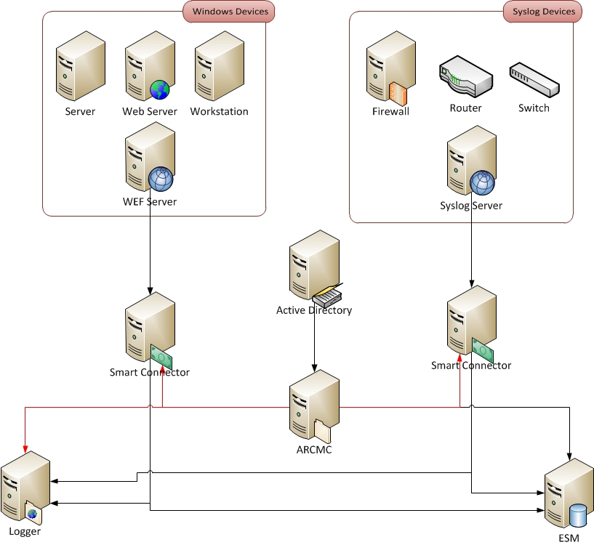
SIEM Components

Slide 11
EndPoint Security
AntiVirus – Central management of all antivirus agents running on hosts. (McAfee EPO, Symantec EP)
AntiMalware/APT – Central management of agents looking for advanced threats or IOCs. (Fireeye, Bit9, ECAT, Cylance, Confer)
File Integrity Monitoring (FIM) – Agent of each server/appliance performs checks on configuration or system/sensitive files.(Tripwire, OSSEC)
Network Access Control (NAC) – Controls what authorized devices are allowed on the network after checking patches, AV, network segment, etc. If not authorized then can bounce to guest network. (Forescout, Cisco ISE)
Mobile Device Management (MDM) – Agent of mobile devices that can restrict apps by time and/or location and remotely wipe lost/stolen devices. (Airwatch, MaS360)
Forensics – Remote agent (or agentless) that can capture running processes, copy hard drives or memory in order to analyze what happened on an infected host. (Encase Enterprise)

Slide 12
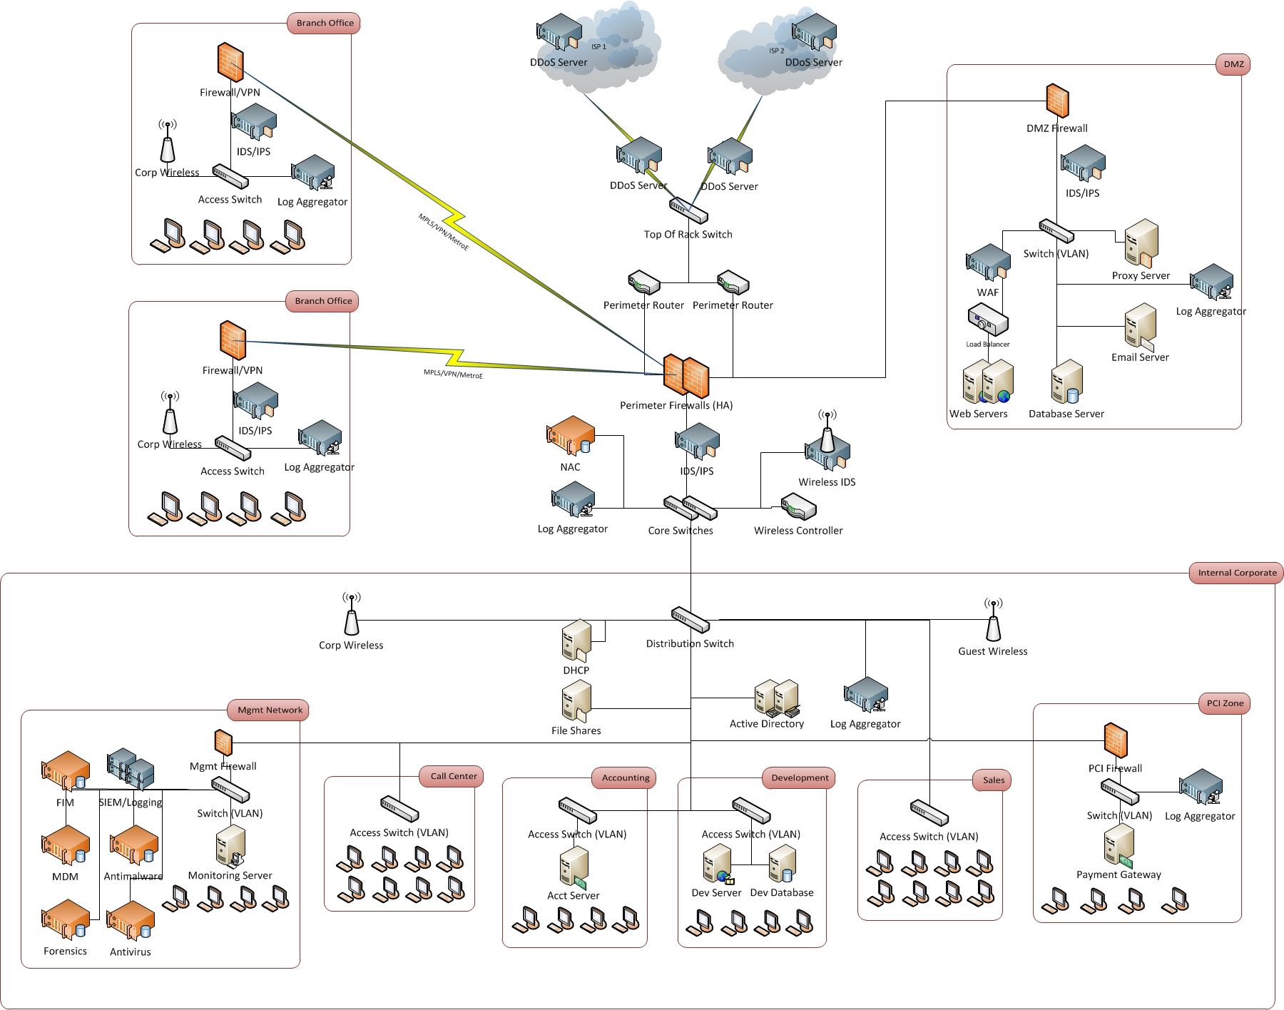
EndPoint Security Diagram

Slide 13
Data Security
Data security usually covers the “crown jewels” of the environment such as customer data or an e-commerce site. Data encryption could cover in transit or at rest.
Data Loss Prevention (DLP) – Can check email, network or hosts and looks for patterns of PII (SSN, CC, Health records) being transmitted in the clear across the network, email or stored unencrypted on a hard drive. (McAfee, ProofPoint, Symantec)
Application Security – Checks code statically and dynamically looking for known programming/application errors such as not sanitizing inputs, dangerous functions, loose permissions, etc. (Appscan, Fortify)
Data Access Manager (DAM) – Acts like a firewall for databases ensuring no unauthorized/malicious queries are allowed to run against the databases. (Imperva, Guardium)

Slide 14
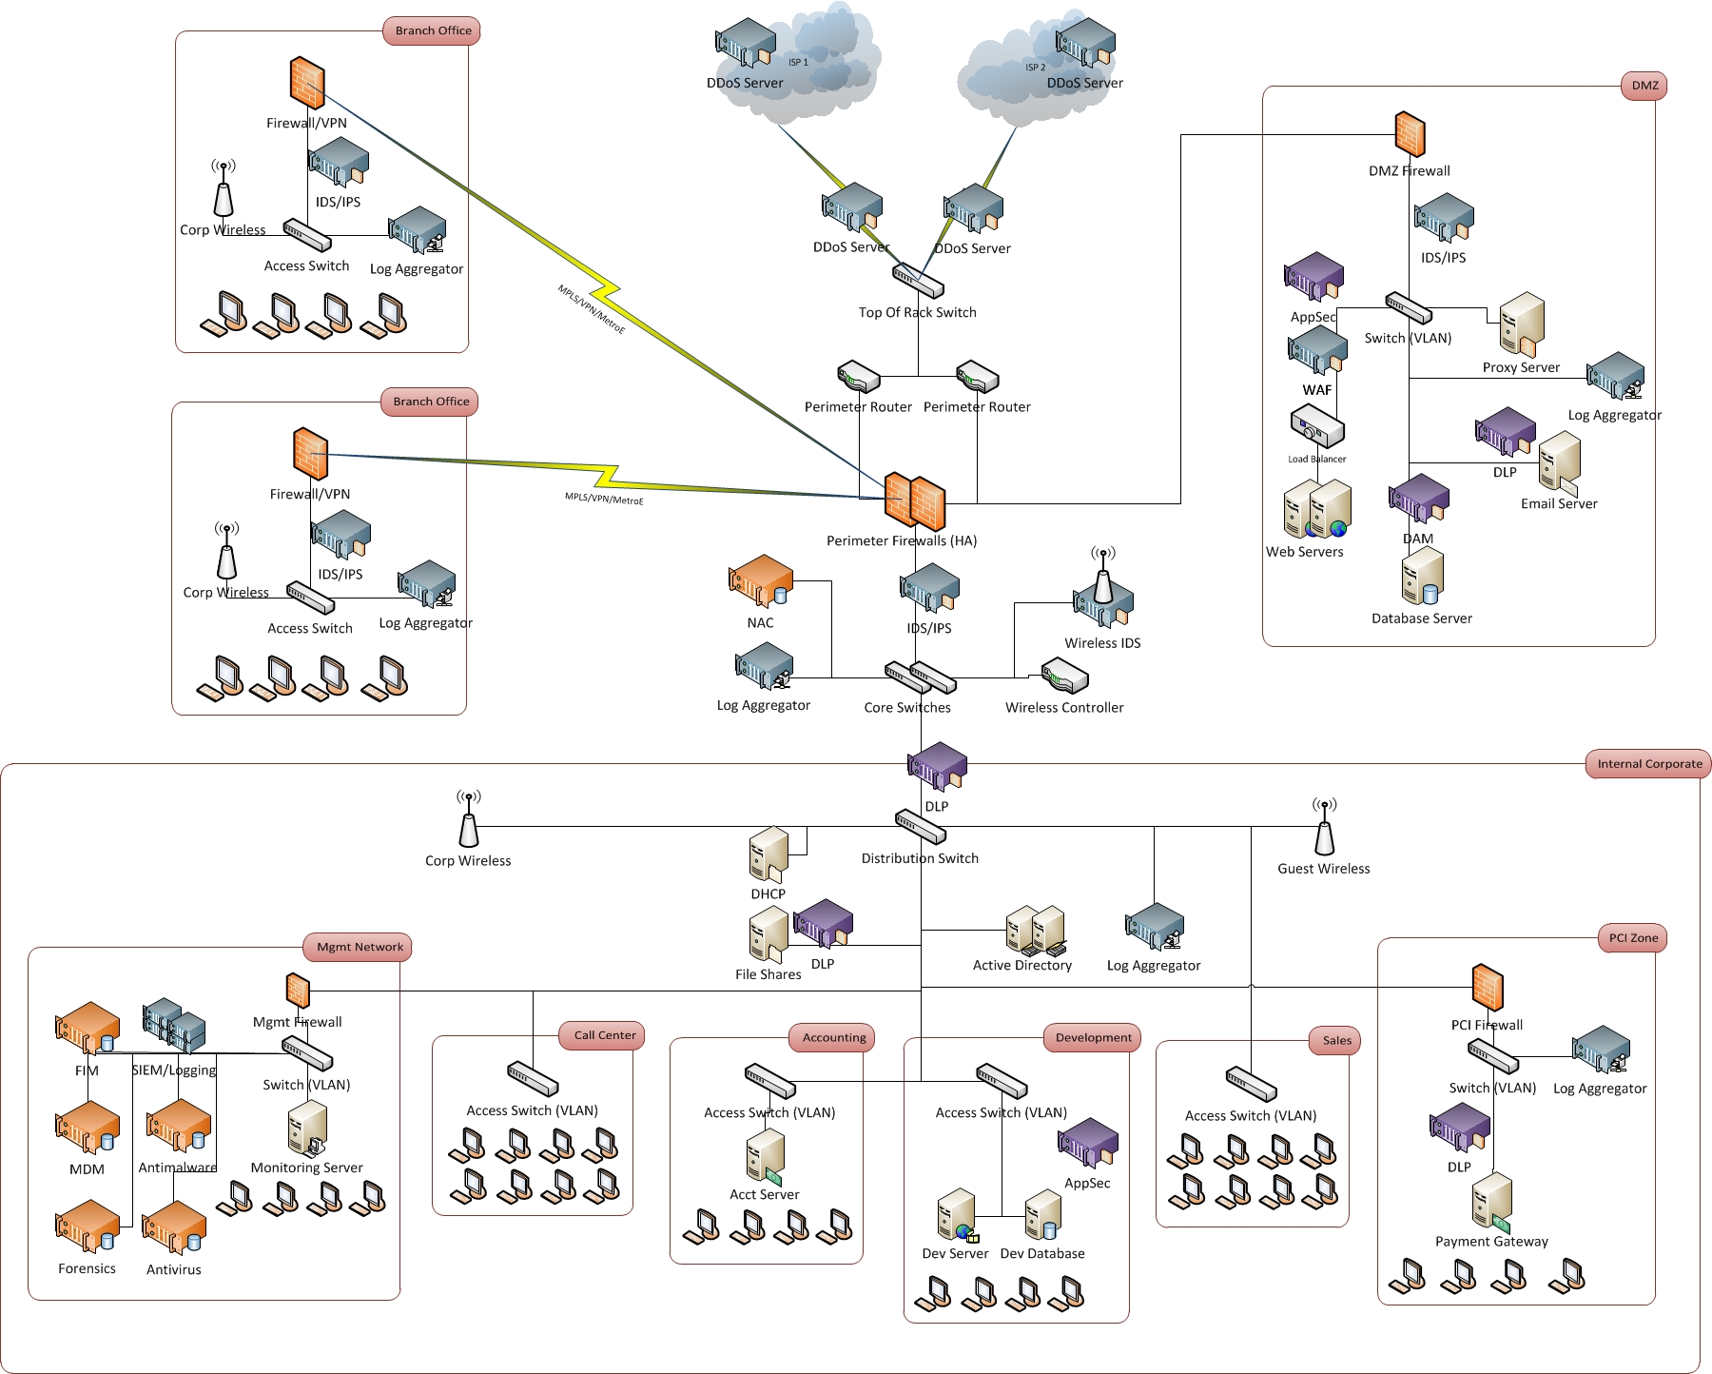
Data Security Diagram

Slide 15
Overall Security Management
Security management is the function to make sure all other controls are in place and functioning correctly. Most commonly falls into one of 2 categories:
Vulnerability Management – Scanning all nodes on the network to look for known vulnerabilities or missing patches. (Nessus, Nexpose, Qualys)
Configuration Management – Ensure all devices are locked down or hardened and firewall rules and routes are what they are supposed to be. (Redseal, Skybox, SolarWinds)

Slide 16
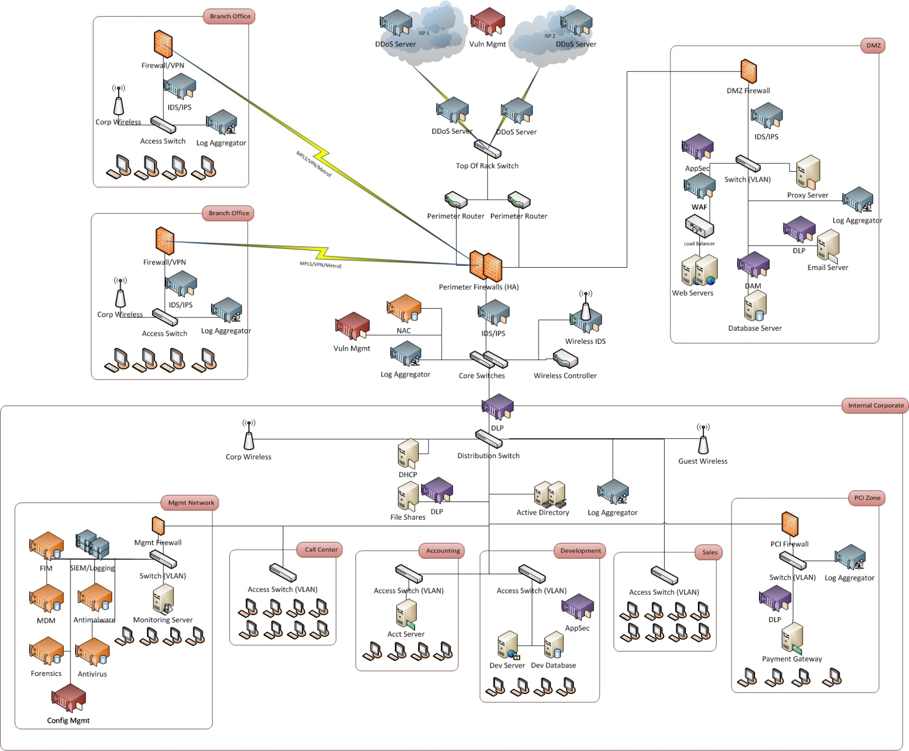
Overall Security Mgmt Diagram

Slide 17
Thank You Questions?
For more information:
Joe Partlow
Web: reliaquest.com | Twitter: @reliaquest
jpartlow@reliaquest.com

